Slide 1
Clinic FINANCIAL OPTIMIZATION model
RADIKA

Slide 2
Content
1
Sales Profit Optimization
2
Dentist Performance Analysis
3
Dentist Scheduling Optimization

Slide 3
Sales profit optimization:
1
Goal:
Determine and calculate maximum profit from each treatment/service and any other income source to get maximum revenue in several scenario
Analysis Method:
Using Linear Equation to formulate every parameters that related to profit and cost to get maximum revenue
Benefit:
Useful to determine to focus on certain treatment that the most profitable
Help to plan and guide the clinic to save some money

Slide 4
Optimization step:
1
Goal:
Getting the problem description
Formulating the mathematical program (define objective function & constraints)
Solving the mathematical program
Performing some post-optimal analysis
Presenting the solution and analysis
Evaluate solution
Define Objective Function & Constraints
Develop Algorithm to solve the Objective Function (Genetic Algorithm)
Generate solution
Valid
Define Problem
Present
No

Slide 5
Constraints:
1
(Example for analysis run)
Working Hour PER MONTH
WORKING HOURLY PER DAY = 8 HOURS, 1 MONTH (22 DAYS) = 22 X8 = 176 HOURS
Service/patient limit per doctor per month
from the excel file maximum service/patient per month = 81
Maximum cogs (cost of sold goods)
from the excel file maximum cogs per month = 15,800,000 idr
Number of worker
dentist = 6
Staff = 2

Slide 6
Objective function
1
$$profit= \sum_{i=1}^{n}{\left(\left(\left(T_{i}−{SD}_{i} −DC_{i}− {COGS}_{i} −LabC_{i}\right)×x_{i}\right)\right)+ {In}_{o}− C_{op} − C_{ot}−C_{ge}}$$
Ti = Trading
T1 = Sales | Basic Scaling
T….
T18 = Sales | Basic Tooth Extraction
SDi = Sales Discount
SD1 = Sales Discount | Basic Scaling
SD..
SD18 = Sales Discount | Basic Tooth Extraction
DCi = Debit Charge
DC1 = Debit Charge | Basic Scaling
DC…
DC18 = Debut Charge | Basic Tooth Extraction
xi = Trading Count
x1 = Sales Count | Basic Scaling
x…
x18 = Sales Count | Basic Tooth Extraction
COGSi = Cost of Goods Sold
COGS1 = Cost of Goods Sold | Basic Scaling
COGS…
COGS18 = Cost of Goods Sold | Basic Tooth Extraction
LabCi = Laboratory cost
LabC1 = Laboratory Cost | Basic Scaling
LabC…
LabC18 = Laboratory Cost | Basic Tooth Extraction
Ino = Other Income
Cop= Operating Expenses
Cot = Other Expense
Cge = General Expense

Slide 7

Model with working hour constraints
1
Profit/month = ((y₁ $×$ x₁) + (y₂ $×$ x₂) + (y₃ $×$ x₃) + (y₄ $×$ x₄) + (y₅$×$x₅)) +${In}_{o}− C_{op}−C_{ot}−C_{eg}$
Subject to:
((y₁ $×$ x₁) + (y₂ $×$ x₂) + (y₃ $×$ x₃) + (y₄ $×$ x₄) + (y₅ $×$ x₅)) <= 176 Hours
Custom projection Financial Simulation constraints:
Profit = ((y₁ $×$ x₁) (y_{n} $×$ x_{i})…_{n}) +${In}_{o}− C_{op}−C_{ot}−C_{eg}$
Subject to:
((y₁ $×$ t₁) + (y_{n} $×$ t_{n})…_{n}) <= Total Hour available
Where :
y_{n} = Service revenue (already deducted by sales discount, debit charge, COGS and Laboratory Cost)
x_{i} = Number of services performed
t_{n} = Service time in hours

Slide 8

Model with patient limit constraints
1
Profit/month = ((y₁ $×$ x₁) + (y₂ $×$ x₂) + (y₃ $×$ x₃) + (y₄ $×$ x₄) + (y₅$×$x₅)) +${In}_{o}− C_{op}−C_{ot}−C_{eg}$
Subject to:
((y₁ $×$ x₁) + (y₂ $×$ x₂) + (y₃ $×$ x₃) + (y₄ $×$ x₄) + (y₅ $×$ x₅)) <= 81 Patients x Number of Doctors
Custom projection Financial Simulation constraints:
Profit = ((y₁ $×$ x₁) (y_{n} $×$ x_{i})…_{n}) +${In}_{o}− C_{op}−C_{ot}−C_{eg}$
Subject to:
sum $\sum_{x_{=1i}}^{n}{x_{i}}$<= Maximum Patient x Number of Doctors
Where :
y_{n} = Service revenue (already deducted by sales discount, debit charge, COGS and Laboratory Cost)
x_{i} = Number of services performed

Slide 9

Model with cogs constraints
1
Profit/month = ((y₁ $×$ x₁) + (y₂ $×$ x₂) + (y₃ $×$ x₃) + (y₄ $×$ x₄) + (y₅$×$x₅)) +${In}_{o}− C_{op}−C_{ot}−C_{eg}$
Subject to:
((y₁ $×$ x₁) + (y₂ $×$ x₂) + (y₃ $×$ x₃) + (y₄ $×$ x₄) + (y₅ $×$ x₅)) <= 15,800,800 IDR
Custom projection Financial Simulation constraints:
Profit = ((y₁ $×$ x₁) (y_{n} $×$ x_{i})…_{n}) +${In}_{o}− C_{op}−C_{ot}−C_{eg}$
Subject to:
((COGS₁ $×$ t₁) + (COGS_{n} $×$ t_{n})…_{n}) <= Maximum total COGS per month
Where :
y_{n} = Service revenue (already deducted by sales discount, debit charge, COGS and Laboratory Cost)
x_{i} = Number of services performed
t_{n} = Service time in hours
${COGS}_{n}$ = COGS for each service

Slide 10
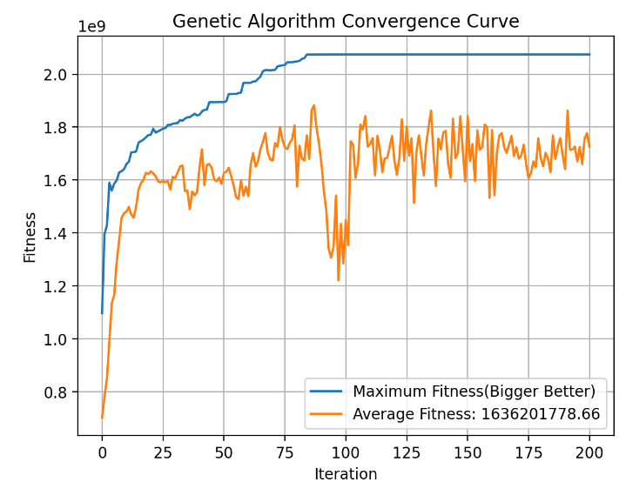
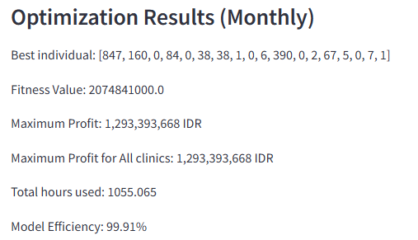
SIMULATION APP OUTPUT
1
Where :
Best Individual: number of count for each treatment
Fitness Value: the maximum score we want to achieve (bigger better)
Maximum Profit: the profit calculation based on Best Individual
Total Hour Used: the total hour needed to satisfy best individual
Model Efficiency: total number of hour used proportional with total hour available

Slide 11
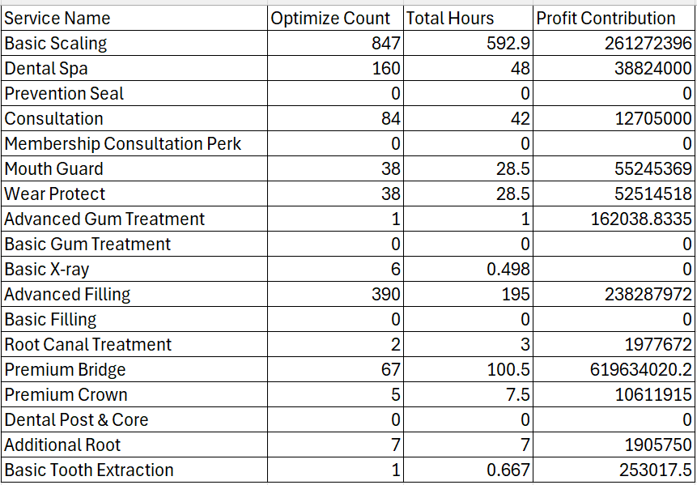
SIMULATION APP OUTPUT
1
Best Individual detailed data-frame

Slide 12
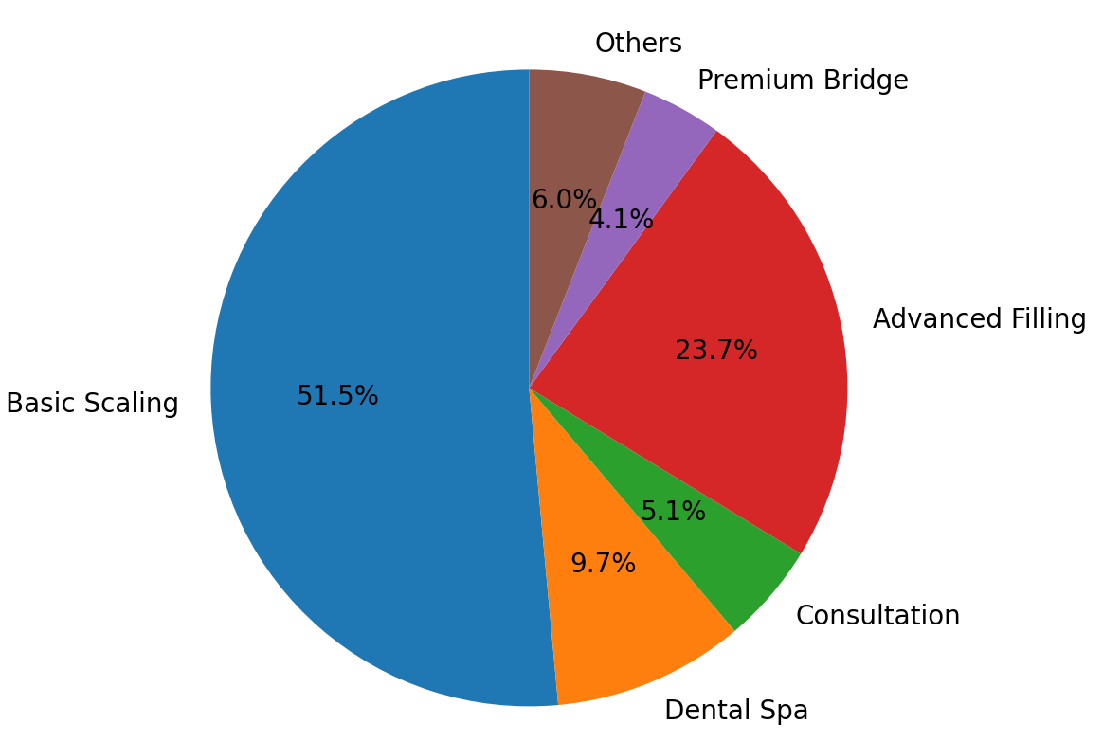
SIMULATION APP OUTPUT
1
Top 5 treatments with highest profit contribution

Slide 13
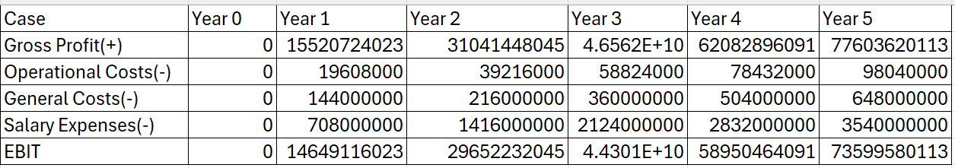
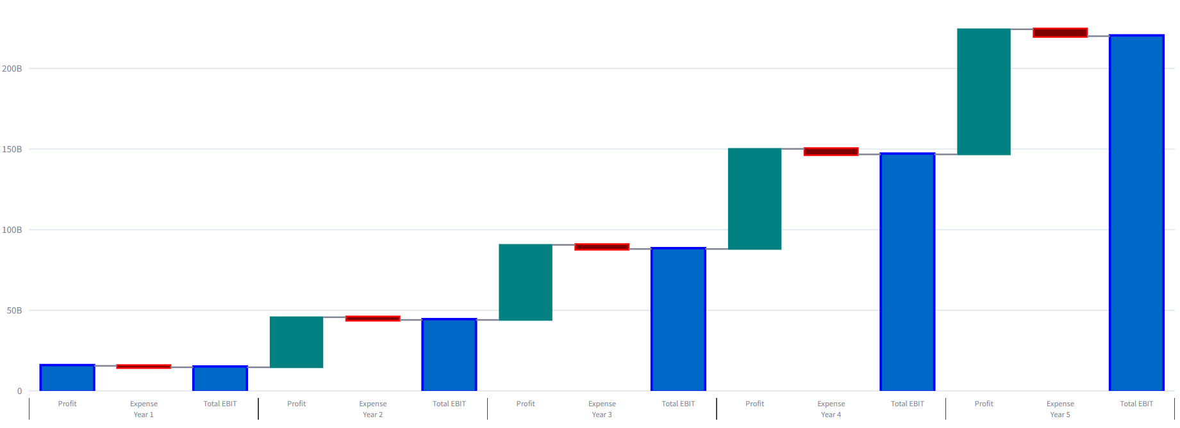
SIMULATION APP OUTPUT
1
5 Year Profit Projection

Slide 14
DENTIST performance analysis:
2
Goal:
To understand dentist performance for evaluation purposes
Analysis Method:
Use statistical analysis to analyze dentist performance from past data for each treatment
Benefit:
Can be a deciding factor for a clinic to do an assessment
Help to evaluate dentist performance to give clear direction and insight for each dentist

Slide 15

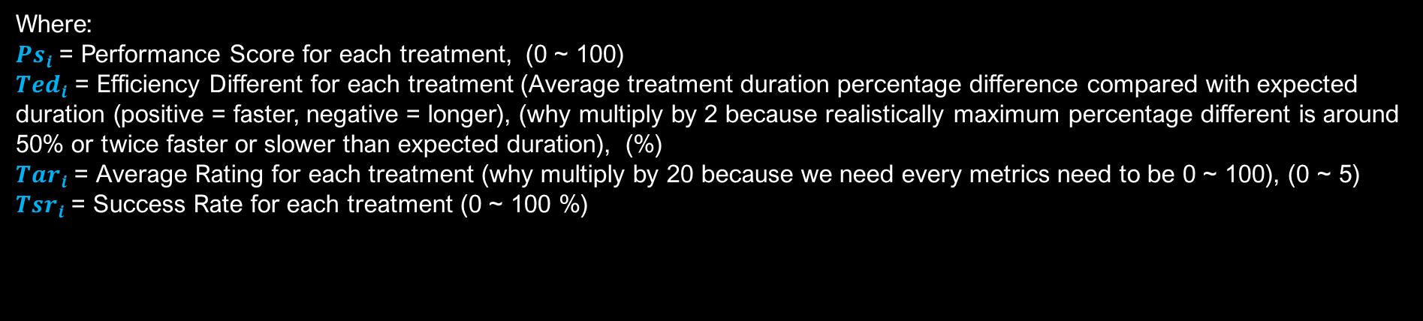
DENTIST performance score:
2
Description:
Range of value from 0 ~ 100 that can be used for dentist performance assessment for each treatment.
Component
The score formula based on several metrics from dentist past treatment data:
Efficiency Different for each treatment (40%)
Average Rating for each treatment (30%)
Success Rate for each treatment (30%)
Formula:
$$Ps_{i}=\left(Ted_{i}×2×0.4\right)+\left(Tar_{i} ×20 ×0.3\right)+(Tsr_{i} x 0.3)$$
Where:
$Ps_{i}$ = Performance Score for each treatment, (0 ~ 100)
$Ted_{i}$ = Efficiency Different for each treatment (Average treatment duration percentage difference compared with expected duration (positive = faster, negative = longer), (why multiply by 2 because realistically maximum percentage different is around 50% or twice faster or slower than expected duration), (%)
$Tar_{i}$ = Average Rating for each treatment (why multiply by 20 because we need every metrics need to be 0 ~ 100), (0 ~ 5)
$Tsr_{i}$ = Success Rate for each treatment (0 ~ 100 %)

Slide 16
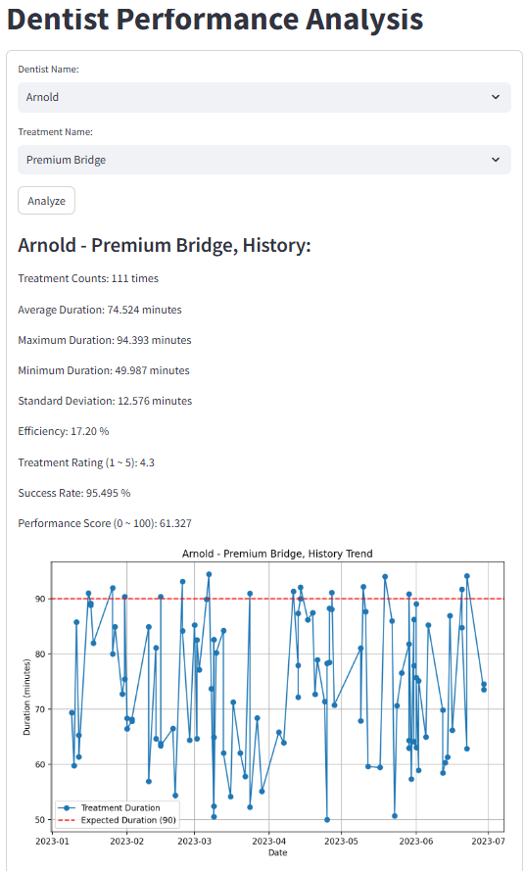
DENTIST performance analysis:
2
Where:
Treatment Counts: How many certain treatment performed by certain dentist for past 6 months
Efficiency: Average treatment duration percentage difference compared with expected duration (positive = faster, negative = longer), (%)
Treatment Rating: Average treatment rating based on customer feedback
Success Rate: Rate of treatment success in one appointment (%)
Performance Score: Score of treatment performance that can be used to decide a treatment specialty for each dentist (let’s assume specialty if Performance Score > 40)

Slide 17
DENTIST SCHEDULING OPTIMIZATION:
3
Goal:
Determine which dentist to assign based to satisfy forecasted demand
Analysis and Optimization Method:
Use dentist past performance data to determine dentist specialty and worth
Use brute force algorithm to find the roster combination with the least labor cost
Benefit:
Save labor cost by assigning the right dentist for the right demand
Flexible workflow

Slide 18
DENTIST SCHEDULING OPTIMIZATION:
3
Algorithm Workflow:
Evaluate solution with constraints
Define Objective & Constraints
Generate first combination with lowest labor cost priority
Generate next random generation based on first combination
No
Valid
No
Better Solution ?
Save the combination
After n-iteration stop the generation
Valid
Present top 5 Schedules
Objective:
Find the least cost of a dentist roster to satisfy forecasted demand
Assign the dentist to demand treatment based on Treatment Score (Specialty) but still consider the cost

Slide 19
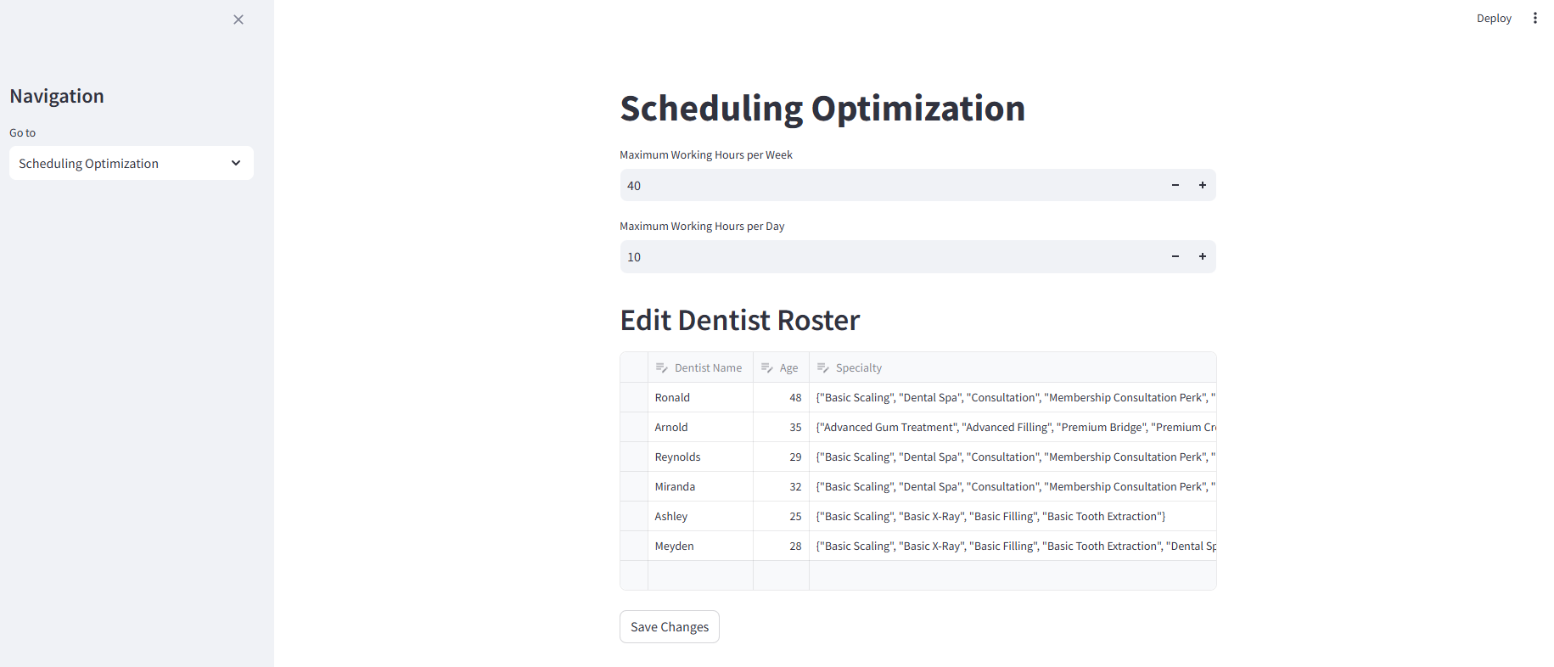
Schedule optimization
3
1
2
1. Navigate to Schedule Optimization page
2. Working hour constraints

Slide 20
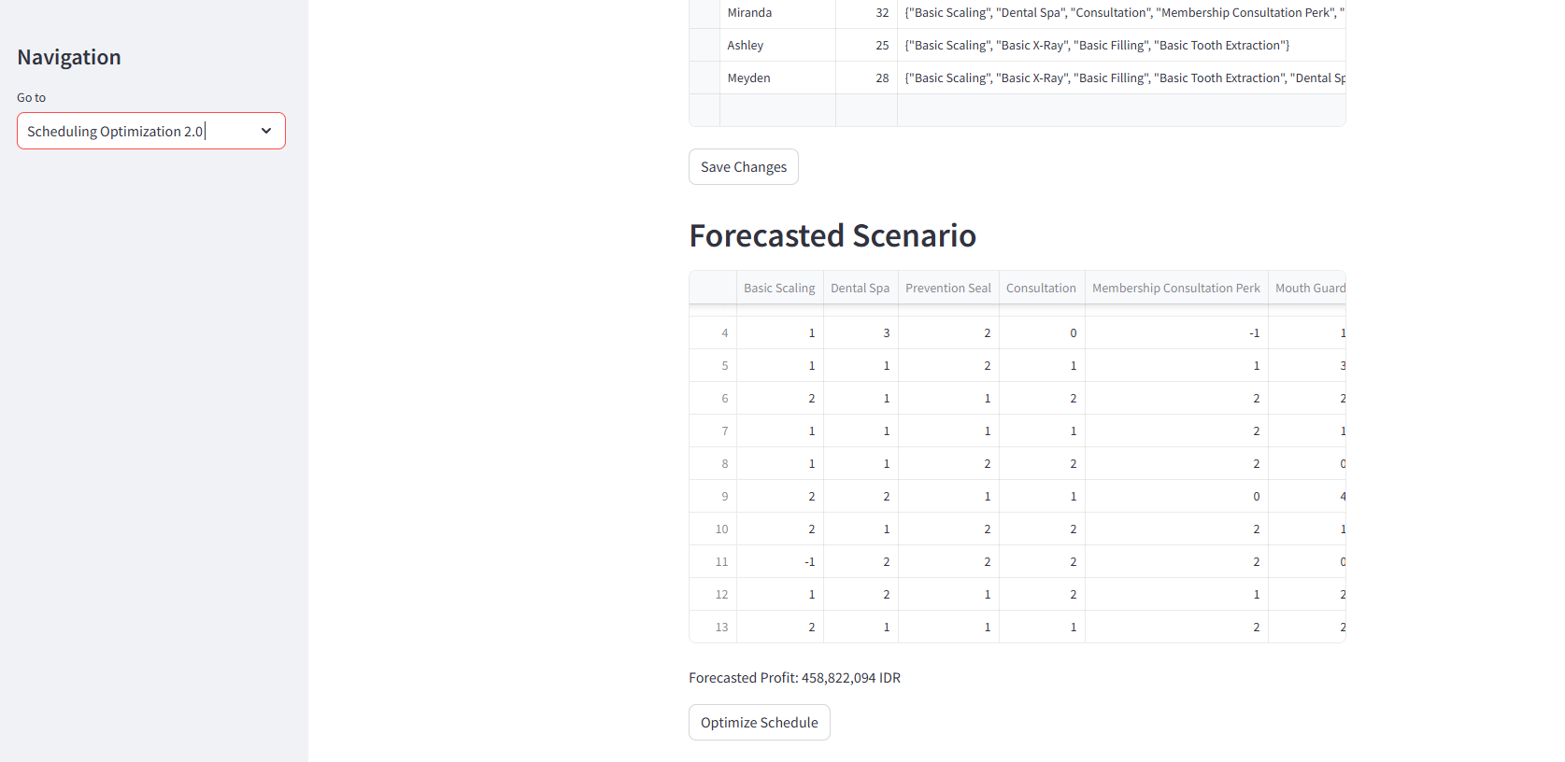
Schedule optimization
3
From dentist past performance analysis, we use guided brute force algorithm to assign dentist roster so satisfy forecasted demand

Slide 21
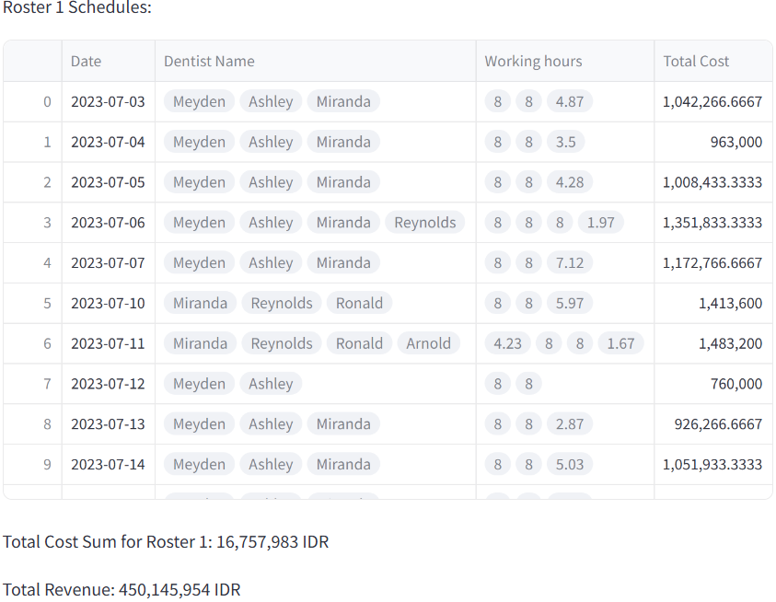
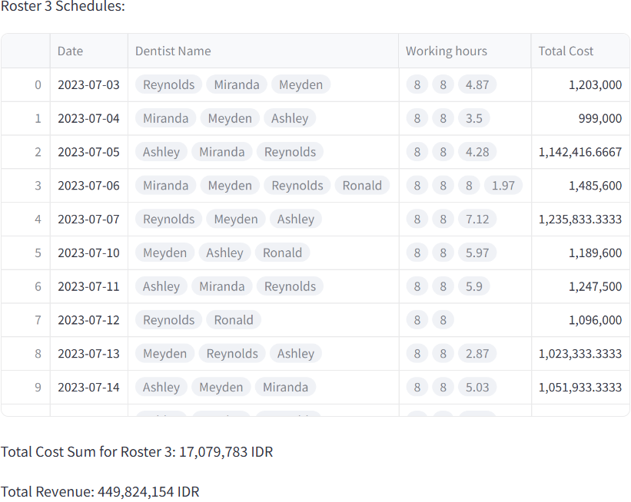
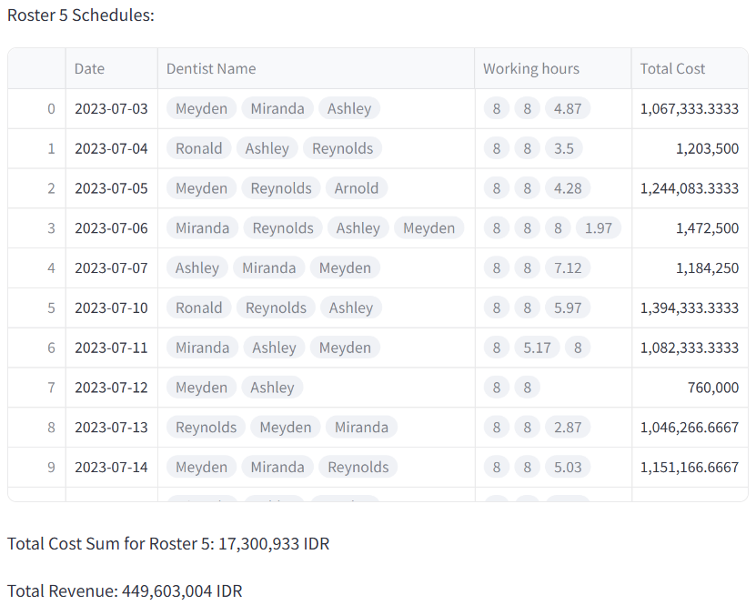
Schedule optimization output
3
Top 5 Schedule sorted by the least labor cost
Constraints:
Maximum working hour per week: 40
Maximum working hour per day: 8

Slide 22
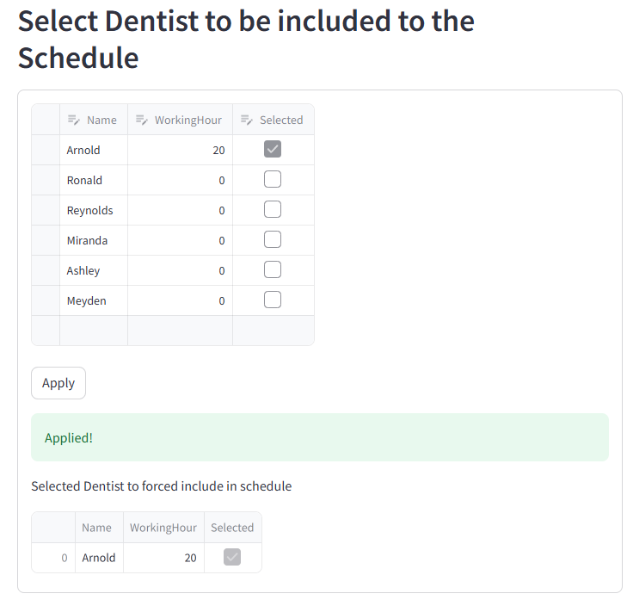
Forced schedule optimization
3
Used for giving dentist a chance to prove themselves if they didn't include in the roster

Slide 23
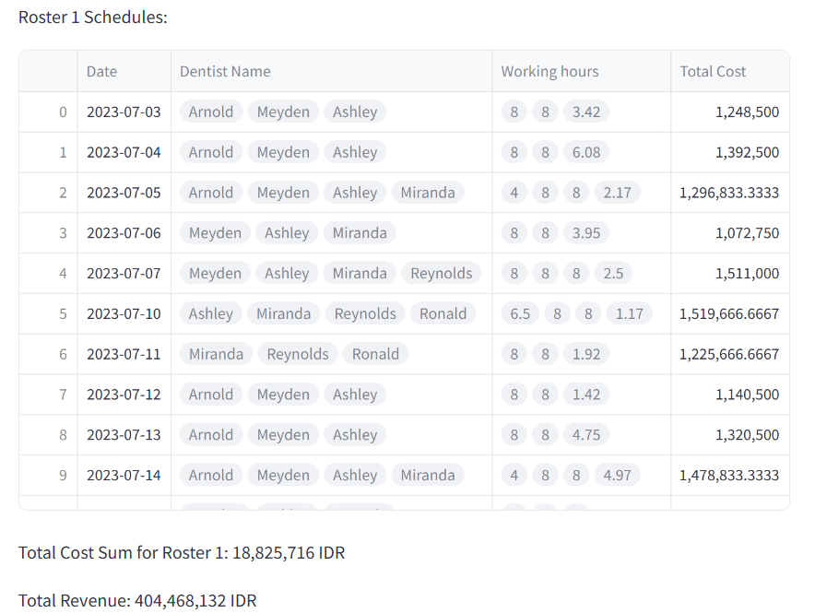
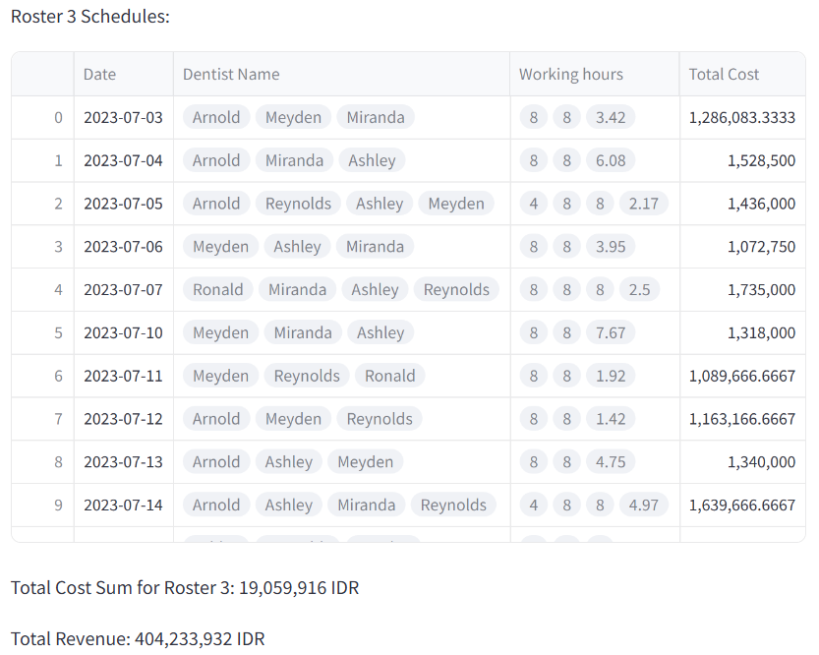
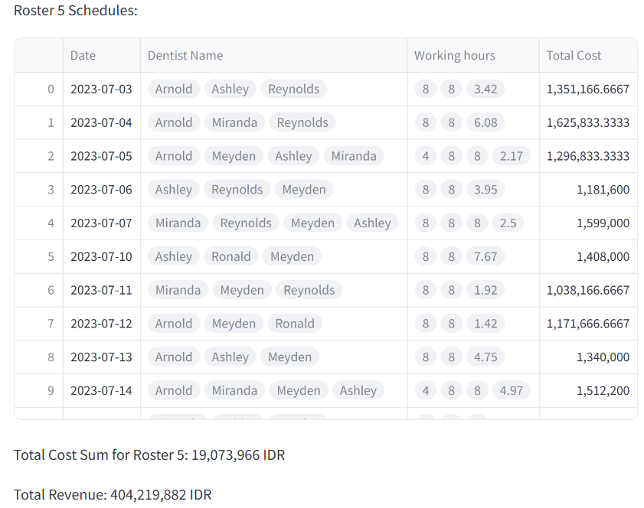
Forced schedule optimization output
3
The algorithm prioritize will override to included the included dentist but still tried to find the least cost roster

Slide 24
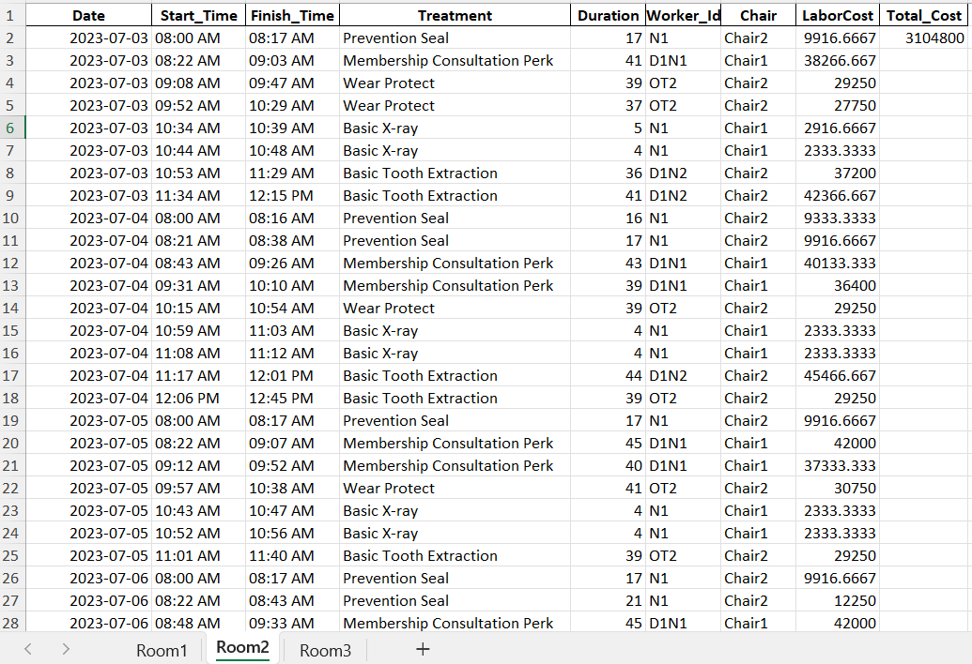
Scheduling optimization v1
3

Slide 25
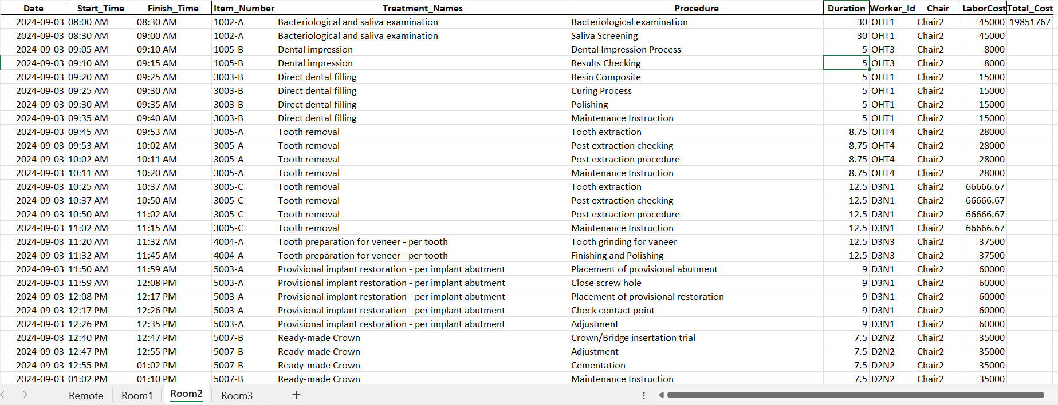
Scheduling optimization v2
3

Slide 26
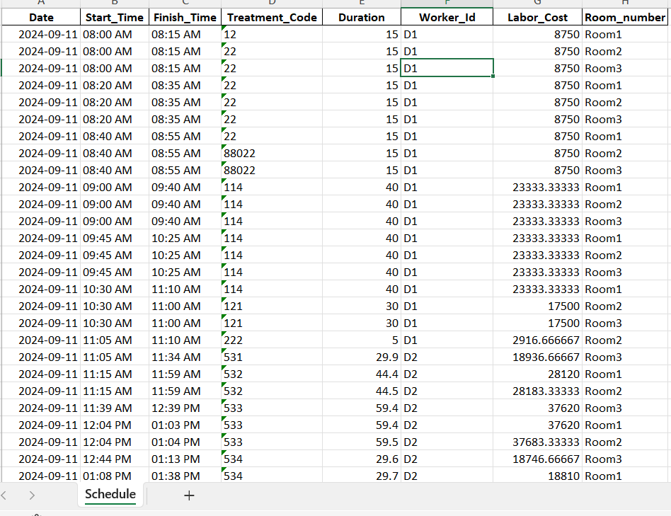
Scheduling optimization v3
3

